Slide 1
VeTrack: Real Time Vehicle Tracking in Uninstrumented Indoor Environments
Mingmin Zhao¹, Tao Ye¹, Ruipeng Gao¹, Fan Ye², Yizhou Wang¹, Guojie Luo¹
EECS School, Peking University, China¹
ECE Dept., Stony Brook University²
ACM SenSys 2015
Seoul, South Korea

Slide 2

Why Real Time Tracking Needed Indoors
Motivation
Non-GPS environments
Underground/multi-level parking structures
Cognitive needs for sense of “control”
Navigation for smart parking services
Find the car upon return
Difficulties
Lack of radio signals (WiFi, cellular)
No Internet/backup support
High costs to instrument the environment

Slide 3
Challenges: Inertial and phone-only
Reliable phone pose estimation
Arbitrary placement/slope surface
Possibly frequent changes due to human/road disturbances
Reliable landmark detection
Landmarks (e.g., speed bumps, turns) to calibrate locations
Distinguishing from hand movements
Balance between tracking accuracy vs. latency
Delayed location decision improves accuracy but increases latency
Notes:
Inspirations
3D->1D
Probabilistic framework with possible calibration
Different parking structures/vehicles/drivers

Slide 4
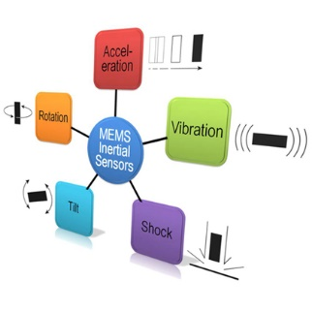
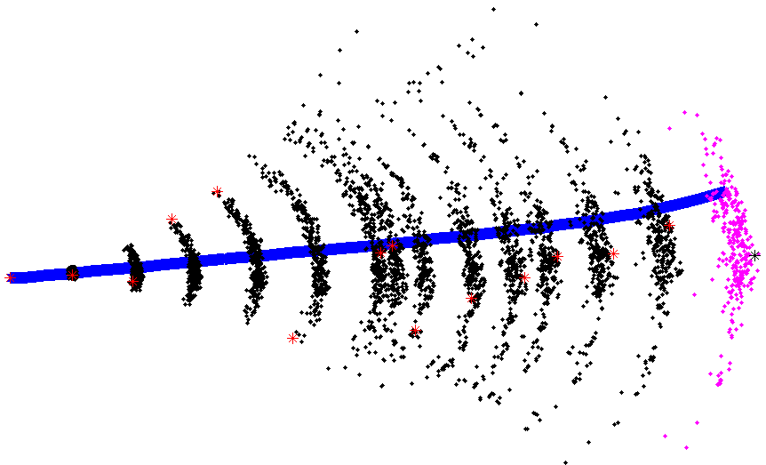
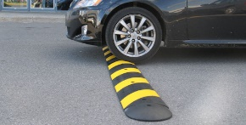
VeTrack overview
Overview
3D→2D pose: “Shadow trajectory” tracing
Tracking: Sequential Monte Carlo framework + road skeleton model
Calibration: landmark detection
Inertial data
3D → 2D
Sequential Monte Carlo
Floor map
2D → 1D
Landmark detection

Slide 5
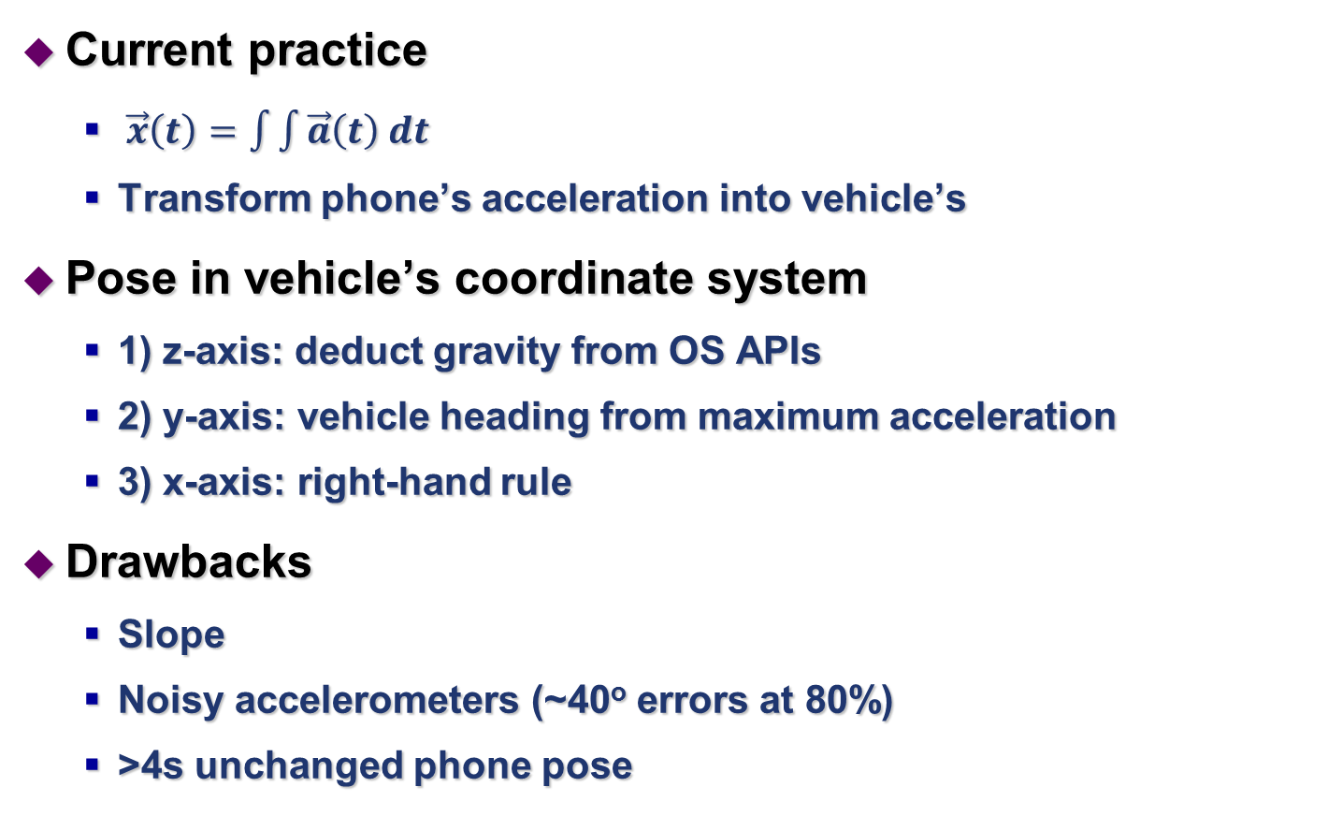
Existing 3D trajectory tracing
Current practice
$\vec{x}\left(t\right)=\int{\int{\vec{a}\left(t\right) dt}}$
Transform phone’s acceleration into vehicle’s
Pose in vehicle’s coordinate system
1) z-axis: deduct gravity from OS APIs
2) y-axis: vehicle heading from maximum acceleration
3) x-axis: right-hand rule
Drawbacks
Slope
Noisy accelerometers (~40º errors at 80%)
>4s unchanged phone pose

Slide 6
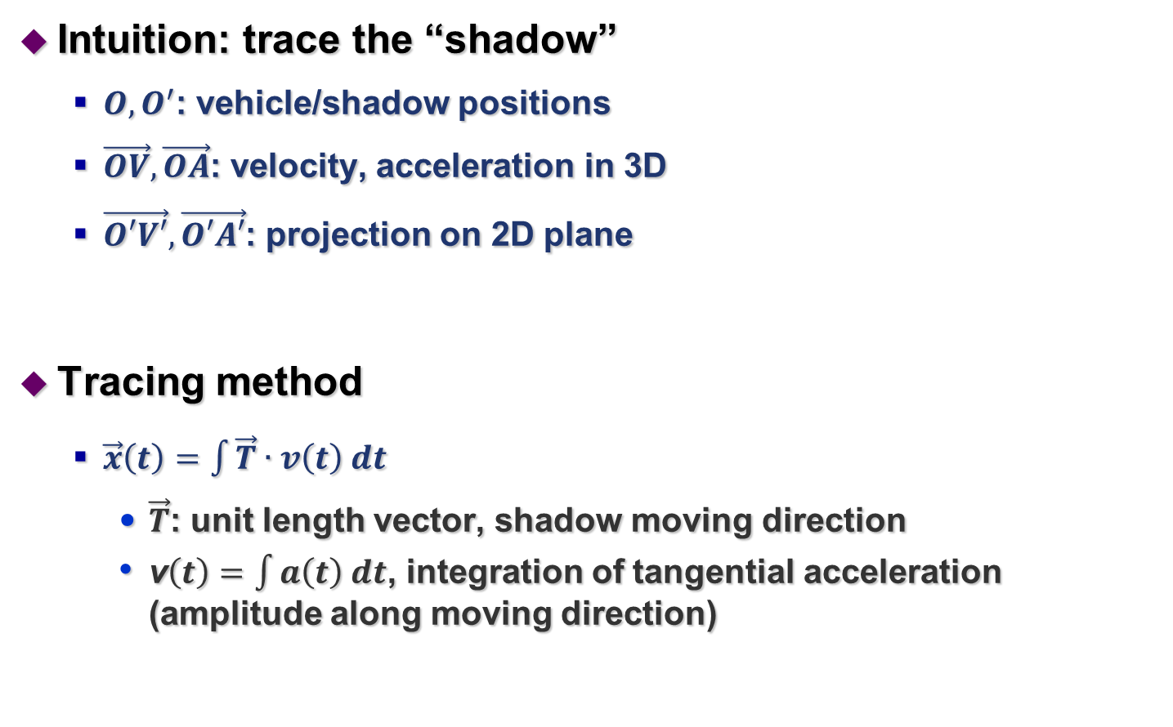
Our 2D Shadow Trajectory Tracing
Intuition: trace the “shadow”
$O,O^{′}$: vehicle/shadow positions
$\vec{OV},\vec{OA}$: velocity, acceleration in 3D
$\vec{O′V′},\vec{O′A′}$: projection on 2D plane
Tracing method
$\vec{x}\left(t\right)=\int{\vec{T}∙v\left(t\right) dt}$
$\vec{T}$: unit length vector, shadow moving direction
v$\left(t\right)=\int{a\left(t\right) dt}$, integration of tangential acceleration (amplitude along moving direction)
O
Notes:
from gyroscope and maps
Eliminate vertical direction noises
$\vec{T}$ estimation reliable from map and gyroscope

Slide 7

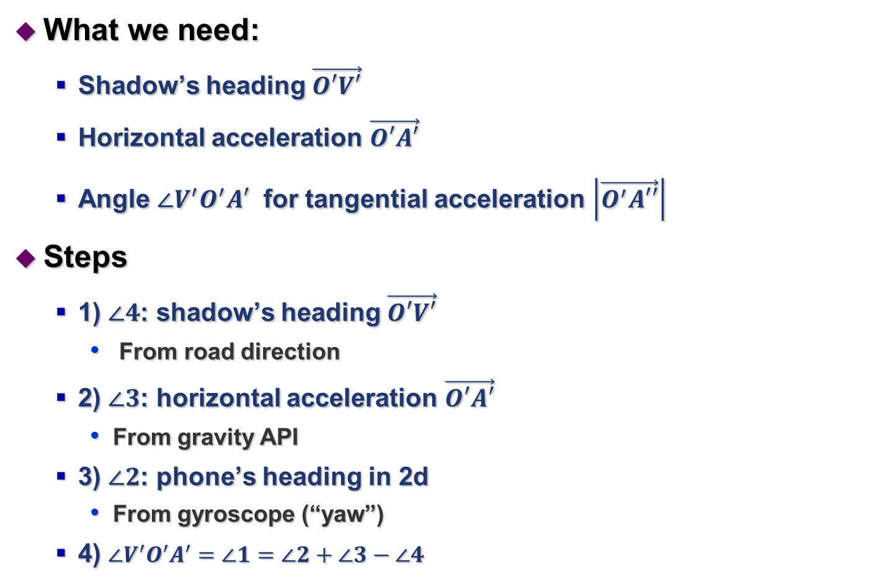
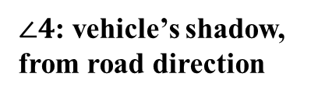
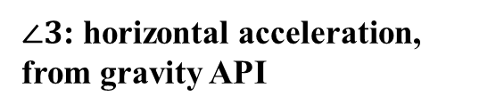
Computing Shadow Trajectory
What we need:
Shadow’s heading $\vec{O′V′}$
Horizontal acceleration $\vec{O′A′}$
Angle $∠V^{′}O^{′}A′$ for tangential acceleration $\left|\vec{O^{′}A′′}\right|$
Steps
1) $∠4$: shadow’s heading $\vec{O′V′}$
From road direction
2) $∠3$: horizontal acceleration $\vec{O′A′}$
From gravity API
3) $∠2$: phone’s heading in 2d
From gyroscope (“yaw”)
4) $∠V^{′}O^{′}A^{′}=∠1=∠2+∠3−∠4$
$∠2$: phone’s heading, from “yaw”
$∠4$: vehicle’s shadow, from road direction
$∠3$: horizontal acceleration,
from gravity API

Slide 8
Advantages of Shadow Tracing
Advantages
1) eliminate variables in vertical dimension
Altitude, angle, speed and acceleration
Noises, complexity
2) accurate vehicle’s shadow direction
Obtained from the road direction
Eliminate inertial noises perpendicular to moving direction
3) use gyroscope to estimate pose
Much more robust than accelerometers
Effects
Handle arbitrary phone and vehicle poses, e.g., slopes
5~10º errors at 80-percentile
Instantaneous pose estimation

Slide 9
Real time tracking
Intuition: combine map and landmark constraints
Road skeleton model

Slide 10
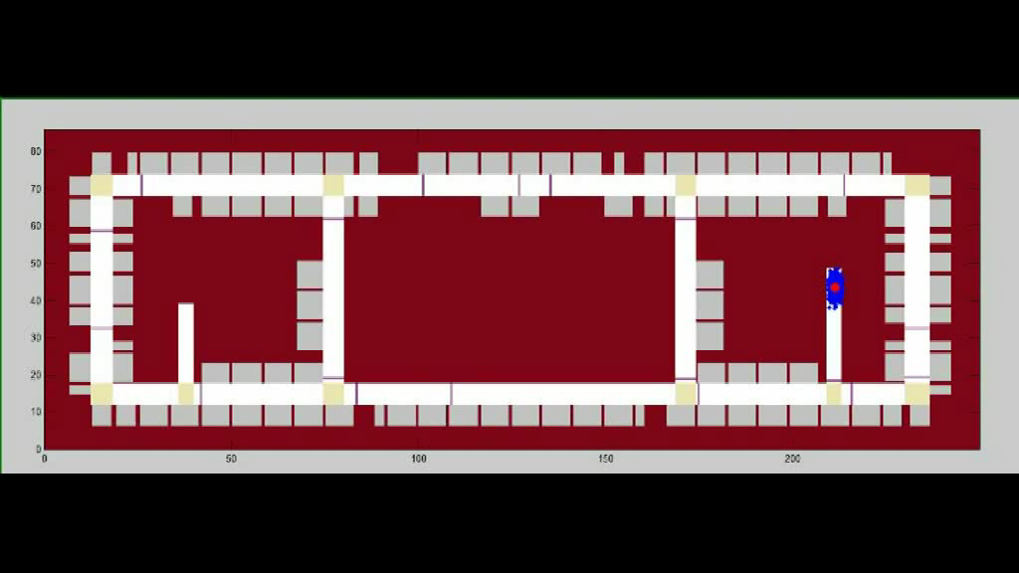
Probabilistic Tracking Framework
Sequential Monte Carlo (SMC) method
1) state update (x,y,v,α, β)
Predict the states of the next time slot
2) weight update
Compute the “likelihood” based on landmark and map constraints
3) resampling

Slide 11
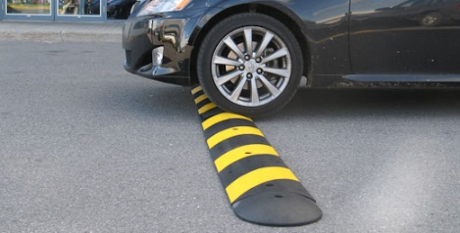
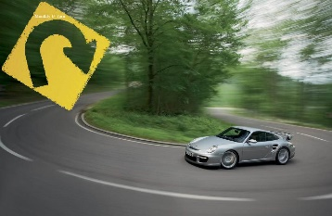
Landmark detection
Landmarks in parking structures
Speed bumps, turns
Vehicle location calibration
Reliable and real time detection is non-trivial
Road conditions
Hand movements
Delay

Slide 12
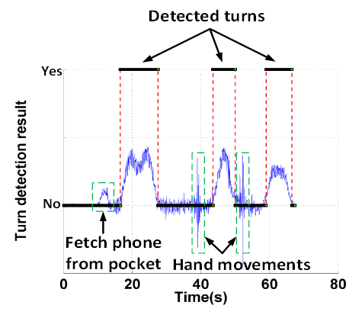
Ambiguities in Landmark Detection
Bumps
Acceleration in the Z-axis
Starting tremors (J)
Hand movement (M)
Turns
Duration of continuous direction changes
Detected from phone’s heading (“yaw”)
Human disturbances

Slide 13
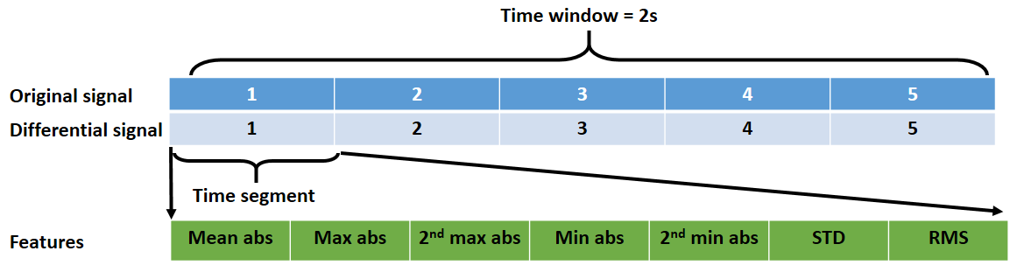
Bump/Turn detection
Feature sets
(1) STAT35
35 dimensions
(2) DSTAT35
70 dimensions
(3) FFT5: first five harmonics
5 dimensions
(4) S7FFT5: FFT5 + two half-size, four quarter-size signals
35 dimensions
(5) DFFT5: FFT5 + differential signals
10 dimensions
Classification
Logistic Regression (LR), Support Vector Machine (SVM)

Slide 14

Avoid detection latency
Prediction and rollback
Signals before/after landmark needed for accuracy
Our intuition: landmarks are rare events
Display, latency=T
No landmark
Display
Display,
Latency<0.2s
Bump!
Rollback
2T
T
T

Slide 15
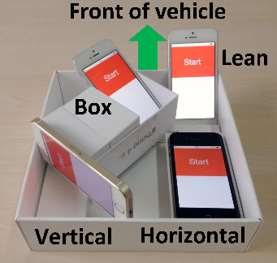
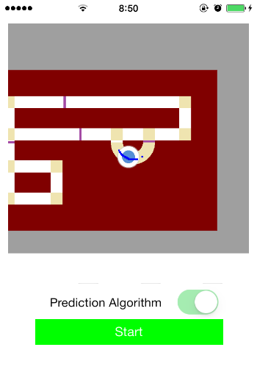
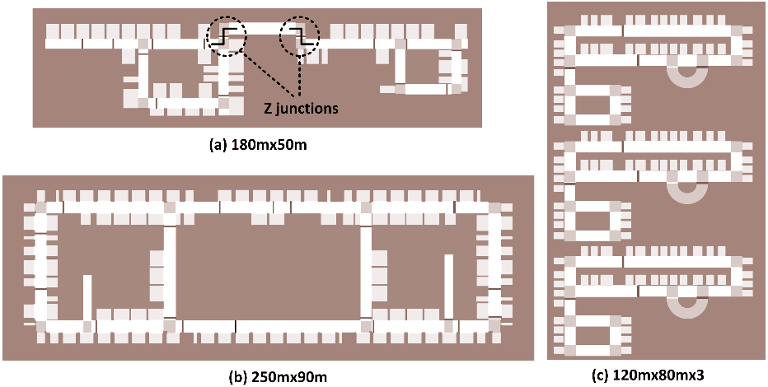
Performance evaluation
Methodology
iPhone 4/4s/5/5s/6
3 underground parking lots
20 trajectories for each chosen parking spot
8 poses for common driving scenarios
A mould to hold 4 iPhones with 4 poses
One in driver's pocket
One in a bag on a seat
Two held in hands with movements
Use video for real time ground truth

Slide 16
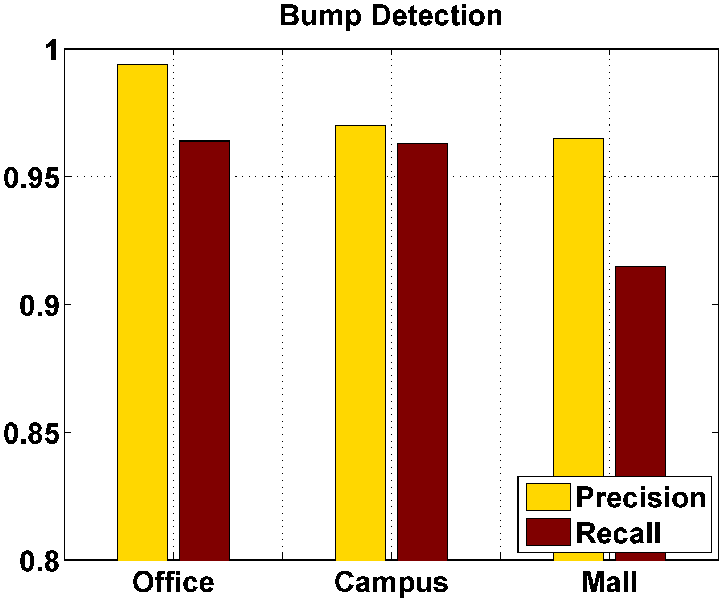
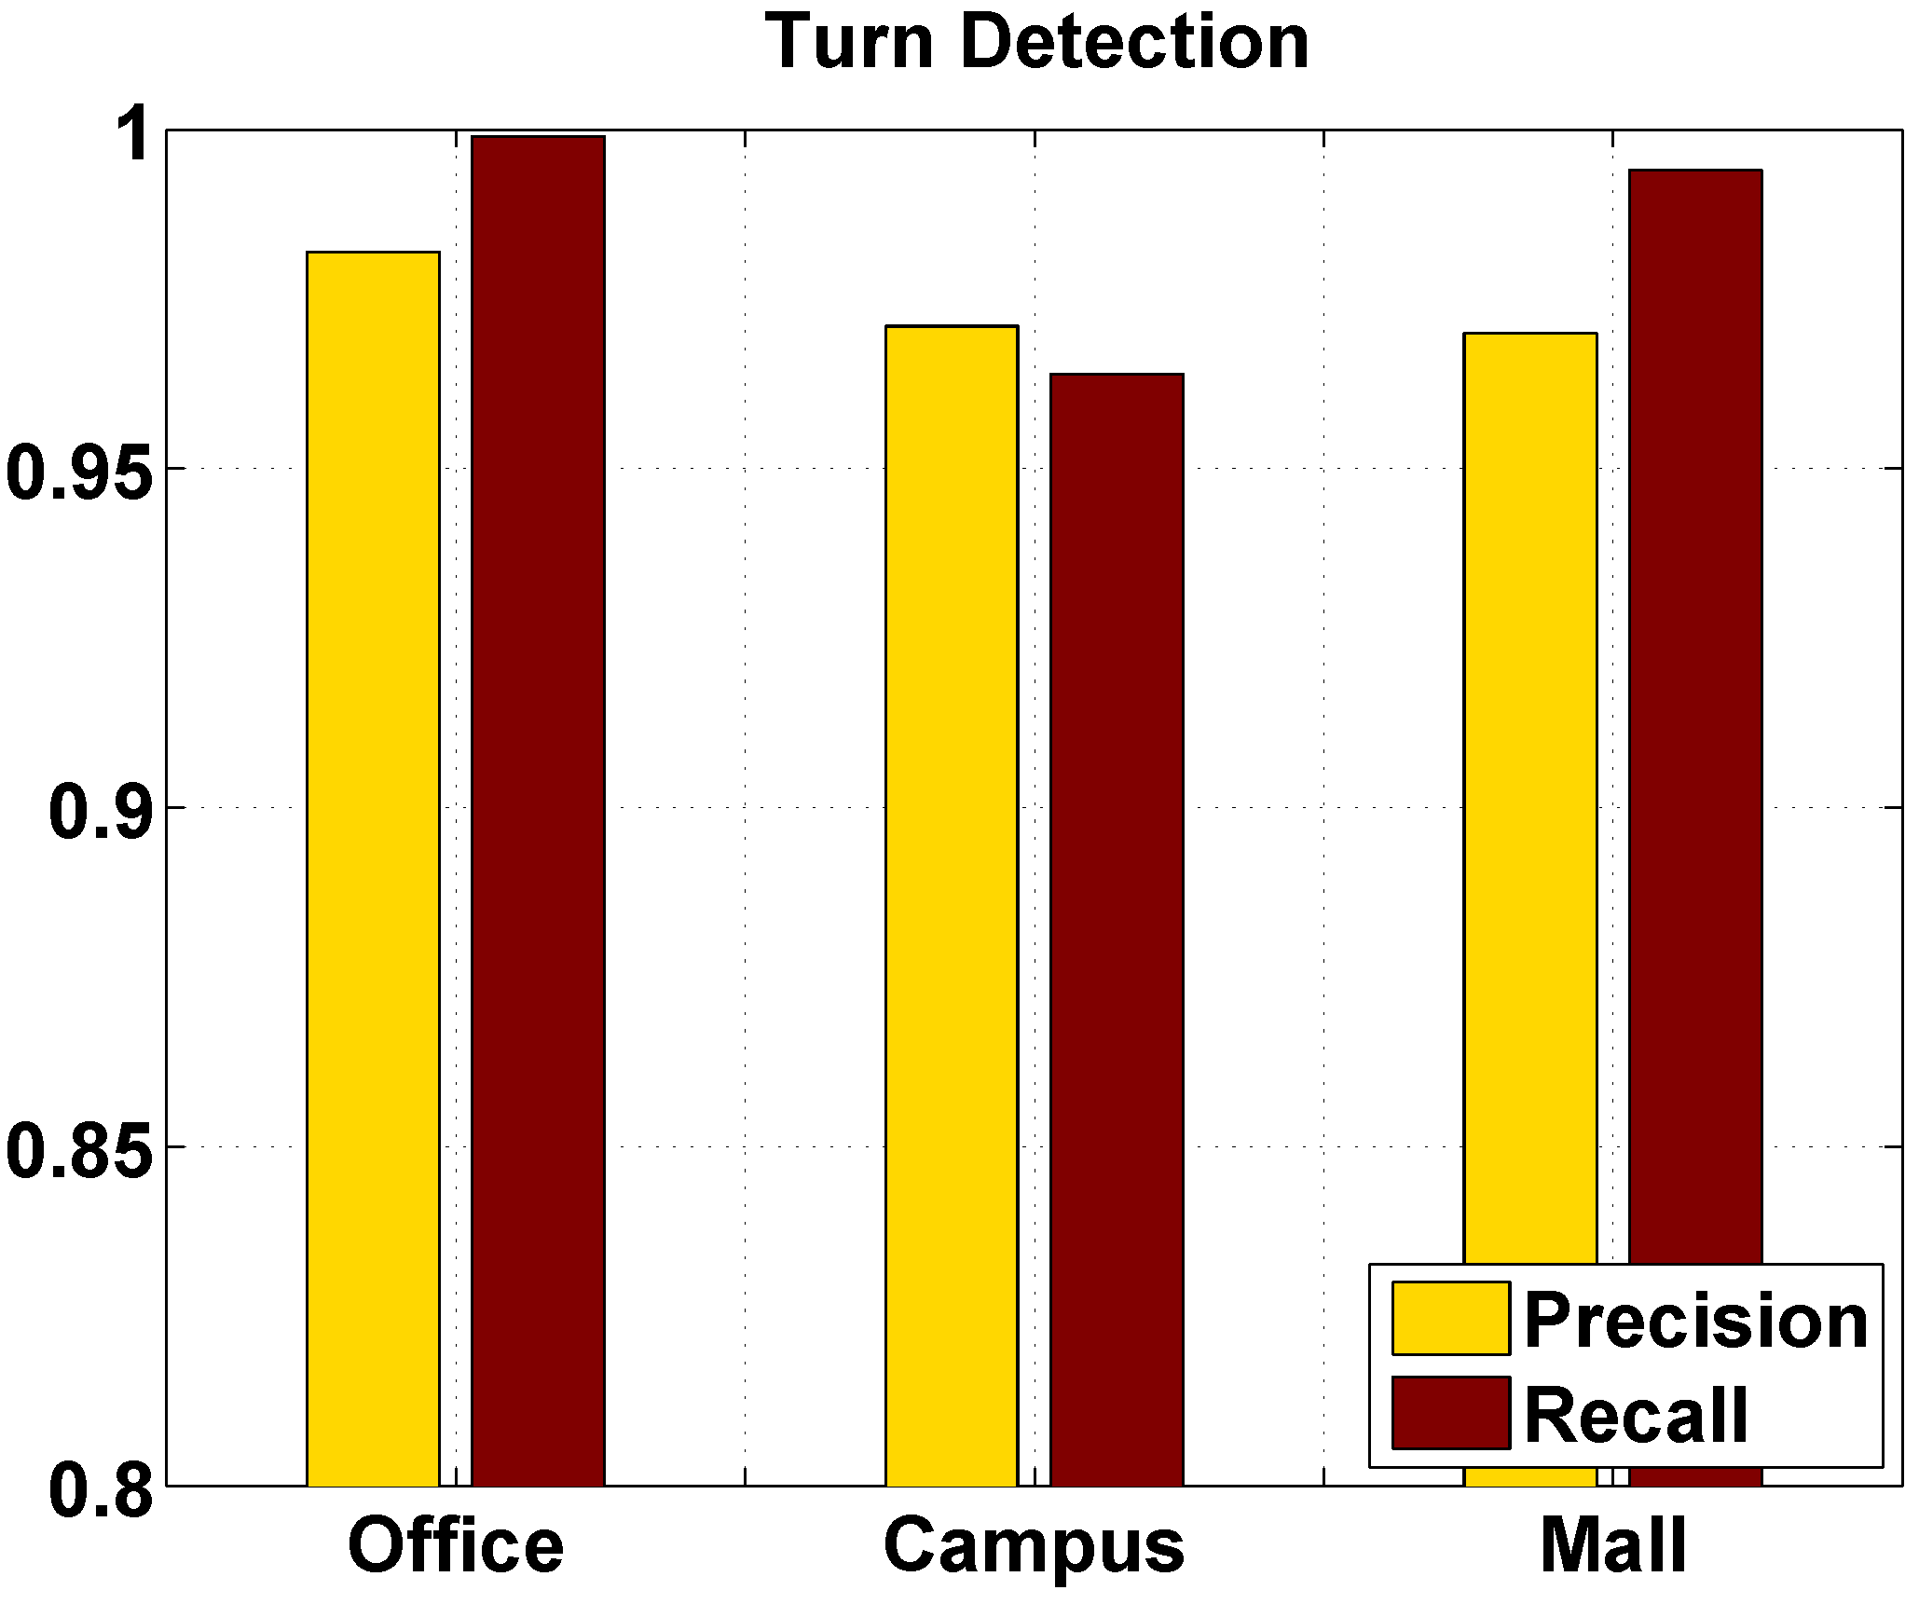
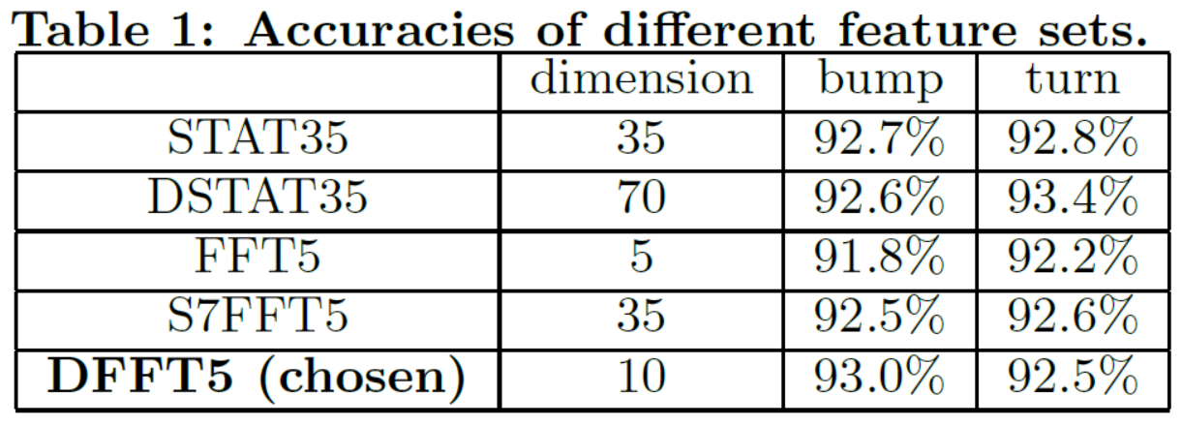
Performance evaluation
Landmark detection
Feature sets
DFFT5: ~93% accuracy, low complexity
Precision & recall
Bump: ~ 91%; Turn: ~ 96%
Mould > pocket/bag >hand

Slide 17
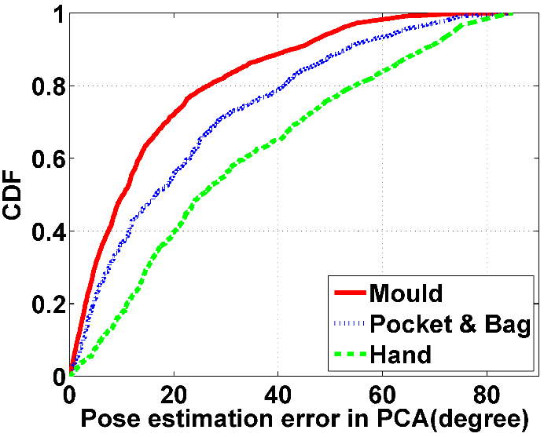
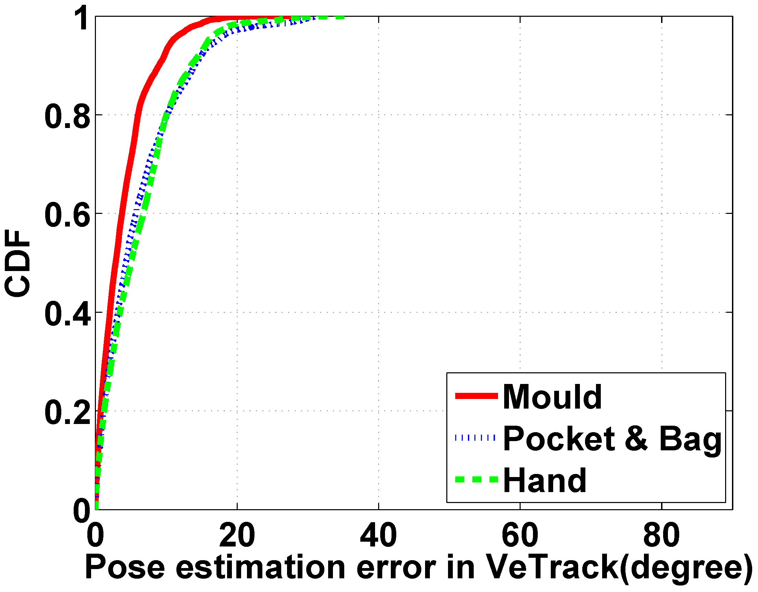
Performance evaluation
Phone pose estimation
3D method: PCA, 50-70º (90%), 4s window
2D: shadow tracing, 10-15º (90%), instantaneous

Slide 18
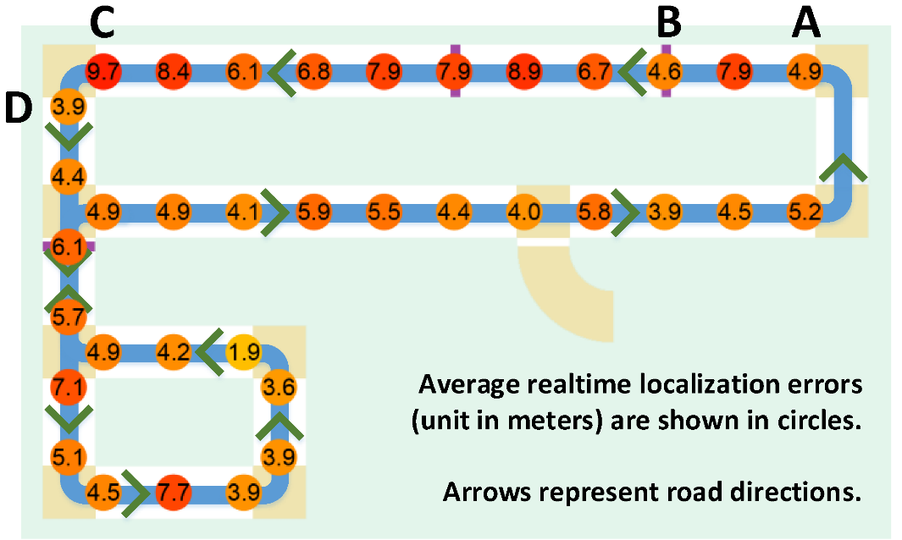
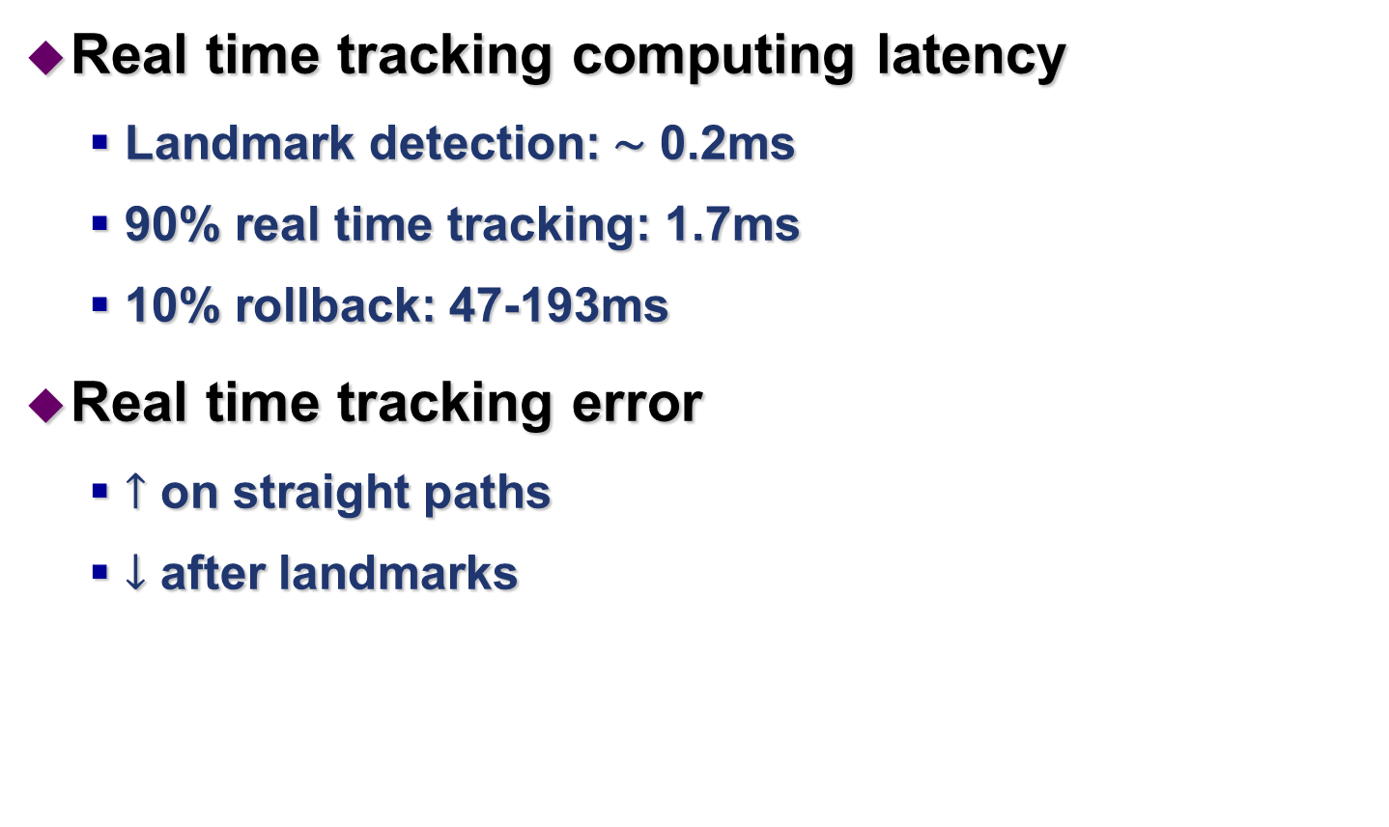
Performance evaluation
Real time tracking computing latency
Landmark detection: ∼ 0.2ms
90% real time tracking: 1.7ms
10% rollback: 47-193ms
Real time tracking error
$↑$ on straight paths
$↓$ after landmarks

Slide 19
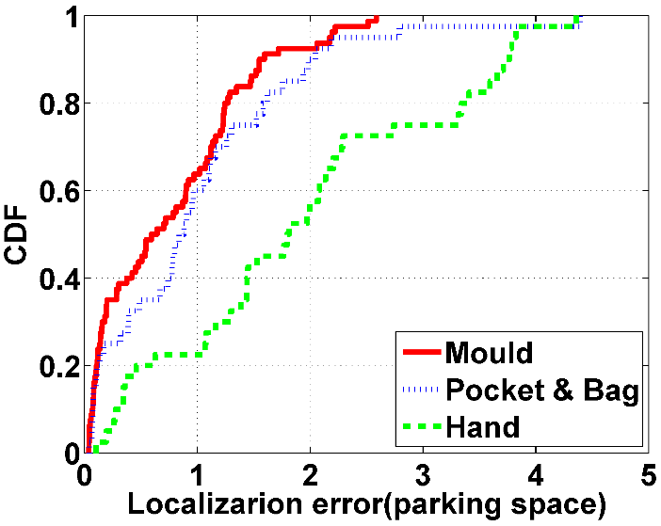
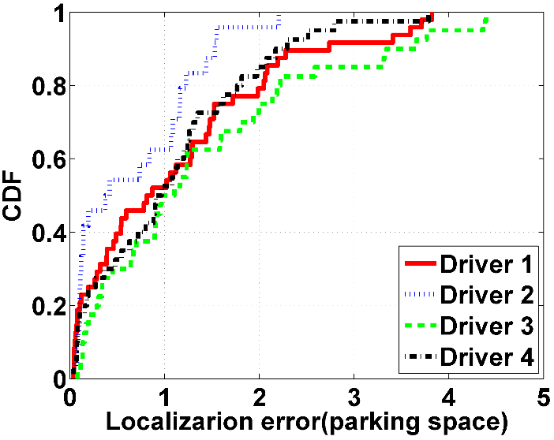
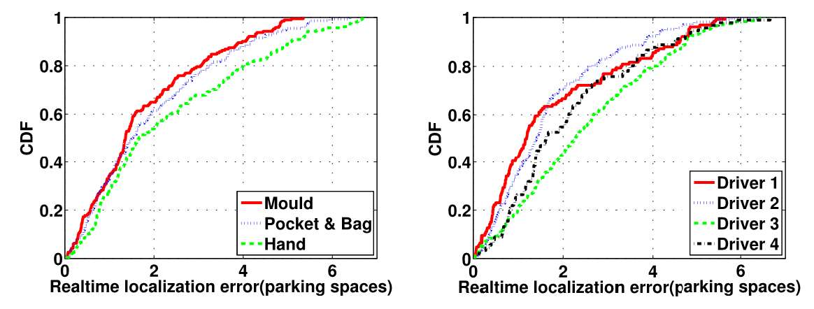
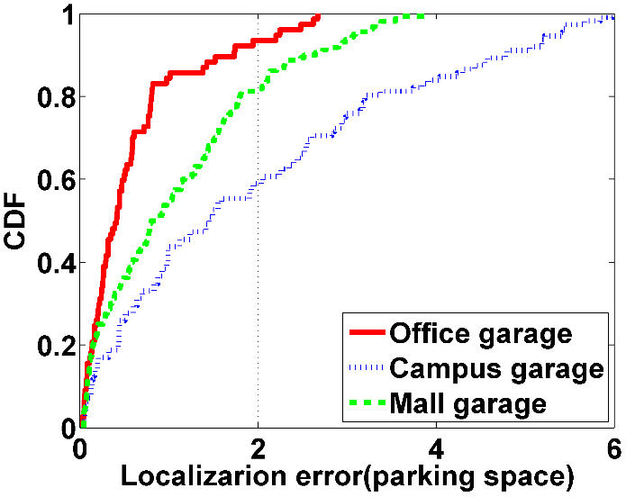
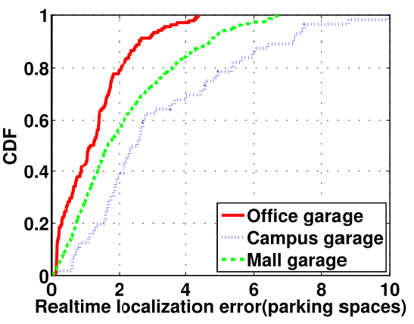
Performance evaluation
Parking/Tracking location errors
Metric: number of parking spaces
8 poses: 90%~2-4, max~3-5 parking space errors
Mould < bag/pocket < hand
Reasonable accuracy across 4 drivers, 3 garages

Slide 20
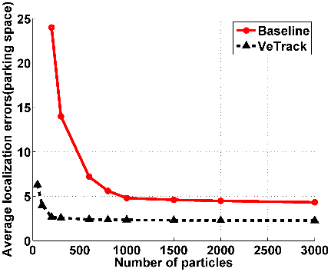
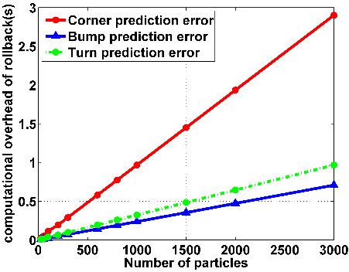
Performance evaluation
Optimal number of particles
Balance between tracking accuracy and rollback latency
200 particles: 2.5 parking spaces error, 0.2s latency

Slide 21
Related work
Phone pose estimation
PCA: not for slopes or frequent pose changes
Robotics
SLAM: unknown maps, high quality data
Dead-reckoning
high precision displacement sensors (e.g., odometry)
Fast error accumulation by commodity devices
Notes:
Estimation of vehicle states
Compute the speed using GPS/RF signal outdoors

Slide 22
Summary
VeTrack: track a vehicle’s location in real time
Inertial data only, computing locally on the phone
Phone pose
Shadow trajectory tracing
Probabilistic framework
Constraints from landmarks and garage maps
Skeleton road model
Landmark detection
Prediction and rollback

Slide 23
Thank you!
Questions?

Slide 24
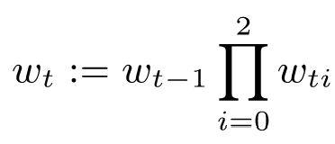
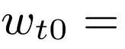
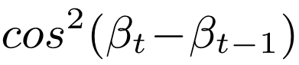
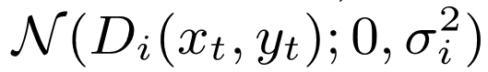
Backup
Particle states:
Level index;
Position on 2D floor plan;
Speed of vehicle;
Phone/vehicle shadow’s 2D heading direction
Weight update
Constraints imposed by the map
Penalize particles that have a drastic change in vehicle heading direction
Detected landmarks
Penalizes the predicted states far away from detected landmarks

Slide 25
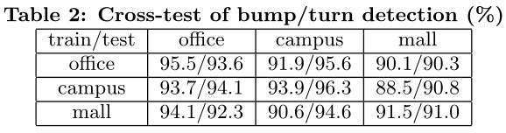
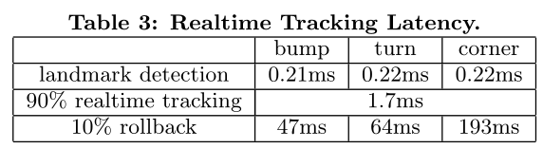
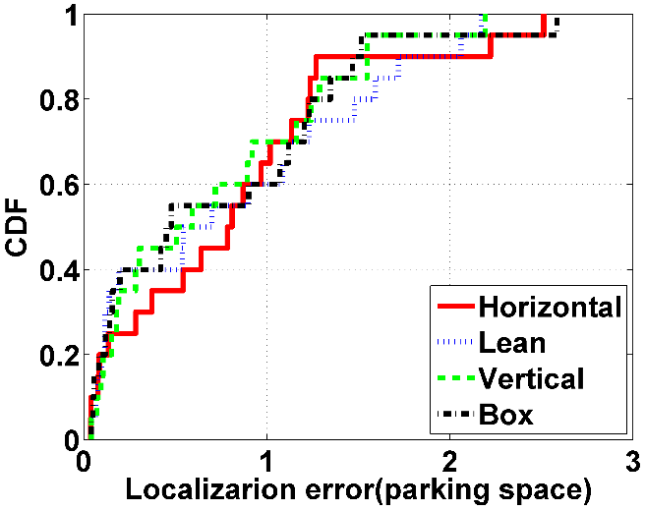
Backup
Cross-test of landmark detection
Real time tracking latency
Different poses in the mould

Slide 26
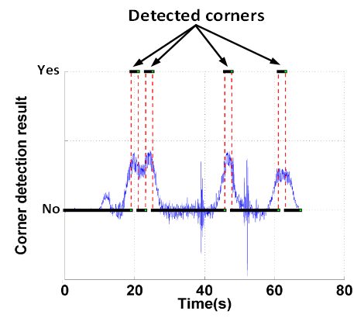
Ambiguities in Landmark Detection
Corners
Consecutive turns
Local maxima

